Slide 1
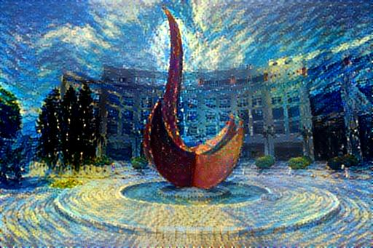
An Introduction to Reinforcement Learning
Yuan YAO
HKUST
Based on Feifei Li, Mengdi Wang, et al.

Slide 2
Supervised Learning
Data: (x, y) x is input, y is output/response (label)
Goal: Learn a function to map x -> y
Examples:
Classification,
regression,
object detection,
semantic segmentation,
image captioning, etc.
Cat

Slide 3
Unsupervised Learning
Data: x Just input data, no output labels!
Goal: Learn some underlying hidden structure of the data
Examples:
Clustering,
dimensionality reduction (manifold learning),
feature learning,
density estimation,
Generating samples, etc.

Slide 4
Today: Reinforcement Learning
Problems involving an agent
interacting with an environment,
which provides numeric reward signals
Goal:
Learn how to take actions in order to maximize reward

Slide 5
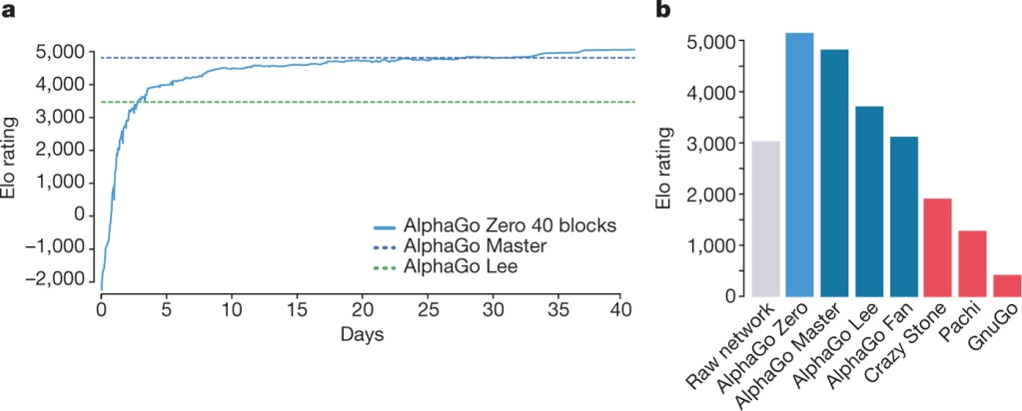
Playing games against human champions
AlphaGo “LEE” 2016
Deep Blue in 1997
AlphaGo ”ZERO” D Silver et al. Nature 550, 354–359 (2017) doi:10.1038/nature24270

Slide 6
Outline
What is Reinforcement Learning?
Markov Decision Processes
Bellman Equation as Linear Programming
Q-Learning
Policy Gradients

Slide 12
Car-Pole Control Problem

Slide 14
Mathematical Formulation of Reinforcement Learning
Markov property: Current state completely characterizes the state of the world

Slide 15
At time step t=0, environment samples initial state s0 ~ p(s0)
Then, for t=0 until done:
Agent selects action at
Environment samples reward rt ~ R( . | st, at)
Environment samples next state st+1 ~ P( . | st; at)
Agent receives reward rt and next state st+1
A policy 𝜋 is a function from S to A that specifies what action to take in each state
Objective: find policy that maximizes the cumulated discounted reward

Slide 20
Bellman Equation of Optimal Value
Remarks
• In the continuous-time analog of MDP, i.e., stochastic optimal control, the Bellman equation is the HJB
• Exact solution methods: value iteration, policy iteration, variational analysis
• What makes things hard:
Curse of dimensionality + Modeling Uncertainty

Slide 21
Bellman Equation as LP (Farias and Van Roy, 2003)

Slide 22
Duality between Value Function and Policy

Slide 23
Online Value-Policy Iteration (Mengdi Wang 2017, arXiv:1704.01869)

Slide 24
Near Optimal Primal-Dual Algorithms
Mengdi Wang, Primal-Dual π Learning, arXiv:1710.0610

Slide 25
Q-Learning

Slide 34
Training the Q-network: Experience Replay
Learning from batches of consecutive samples is problematic:
Samples are correlated => inefficient learning
Current Q-network parameters determines next training samples (e.g. if maximizing action is to move left, training samples will be dominated by samples from left-hand size) => can lead to bad feedback loops
Address these problems using experience replay
Continually update a replay memory table of transitions (s_{t}, a_{t}, r_{t}, s_{t+1}) as game (experience) episodes are played
Train Q-network on random minibatches of transitions from the replay memory, instead of consecutive samples
Each transition can also contribute to multiple weight updates => greater data efficiency

Slide 36
Example
https://www.youtube.com/watch?v=V1eYniJ0Rnk

Slide 37
Policy Gradients
What is a problem with Q-learning? The Q-function can be very complicated!
Example: a robot grasping an object has a very high-dimensional state => hard to learn exact value of every (state, action) pair
But the policy can be much simpler: just close your hand Can we learn a policy directly, e.g. finding the best policy from a collection of policies?

Slide 51
Pytorch Implementation
https://github.com/kevinzakka/recurrent-visual-attention
A Pytorch implementation for the paper, Recurrent Models of Visual Attention by Volodymyr Mnih, Nicolas Heess, Alex Graves and Koray Kavukcuoglu, NIPS 2014.

Slide 53
Summary
Policy gradients: very general but suffer from high variance so requires a lot of samples. Challenge: sample-efficiency
Q-learning: does not always work but when it works, usually more sample-efficient. Challenge: exploration
Guarantees:
Policy Gradients: Converges to a local minima, often good enough!
Q-learning: Zero guarantees since you are approximating Bellman equation with a complicated function approximator

Slide 54
Thank you!

